Slide 1
Get Productive!
HCI Project 2017 Team: Felix Felicis
Date: 02.11.2017

Slide 2
Team members
Presented to
Dr. Moinul Islam Zaber
Associate Professor
Dr. Amin Ahsan Ali
Assistant Professor
Tanzir Islam (1)
Roza Tabassum (13)
Meem Arafat (25)
Shahreen Salim (33)
Melody Soptaka (43)

Slide 3
Overview
Problem identification
What we need
Proposed solution
Our app
Basic activities
Work flow
User Response
Future directions
Demo of the Application

Slide 4
Problem identification

Slide 5
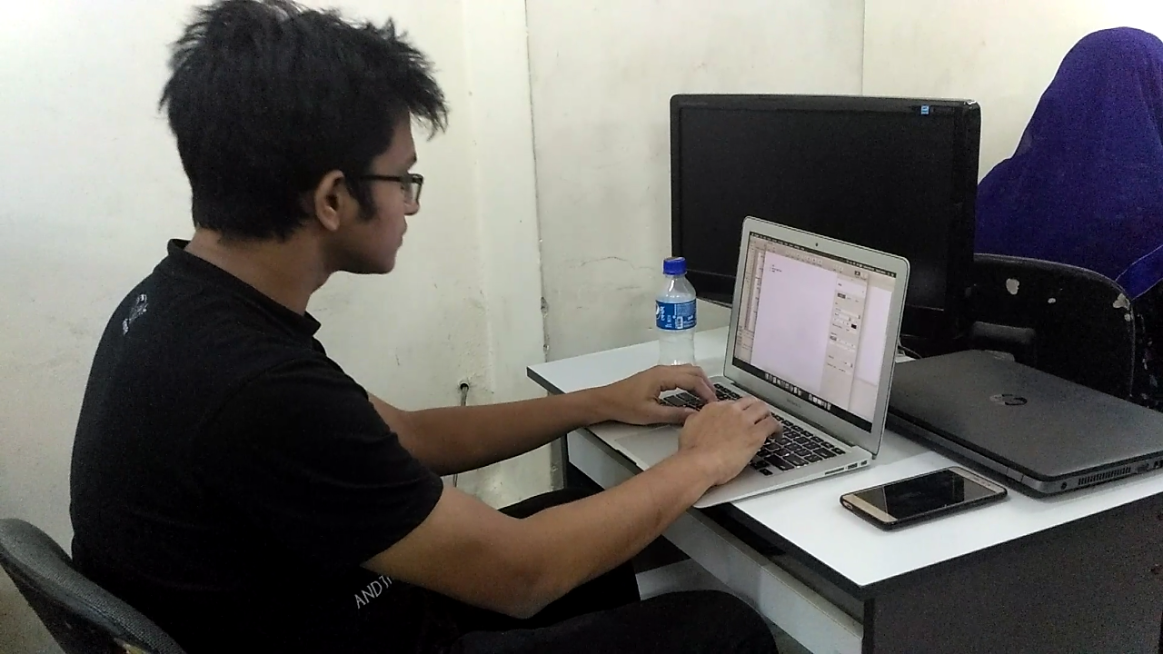
Scenario 1
Tanzir is trying to focus on his work but due to excessive notification alerts, he can not keep his attention for long.

Slide 6
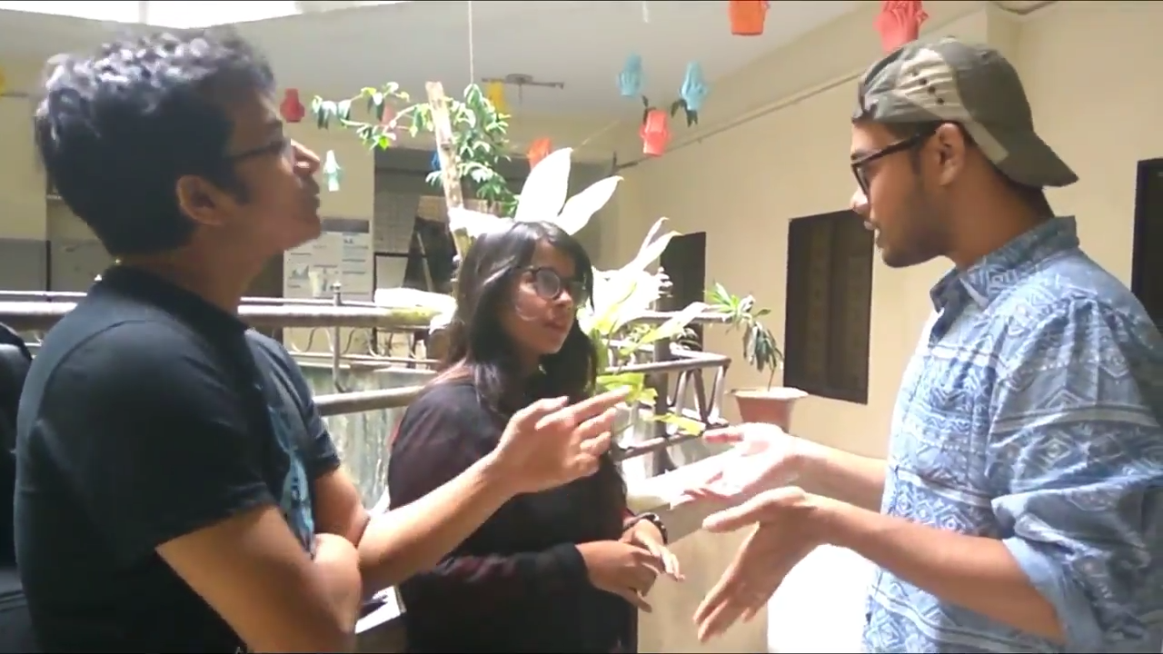
Scenario 2
Again, Tanzir is hanging out with his friends. But, his phone keeps buzzing and this annoys his friends.

Slide 7
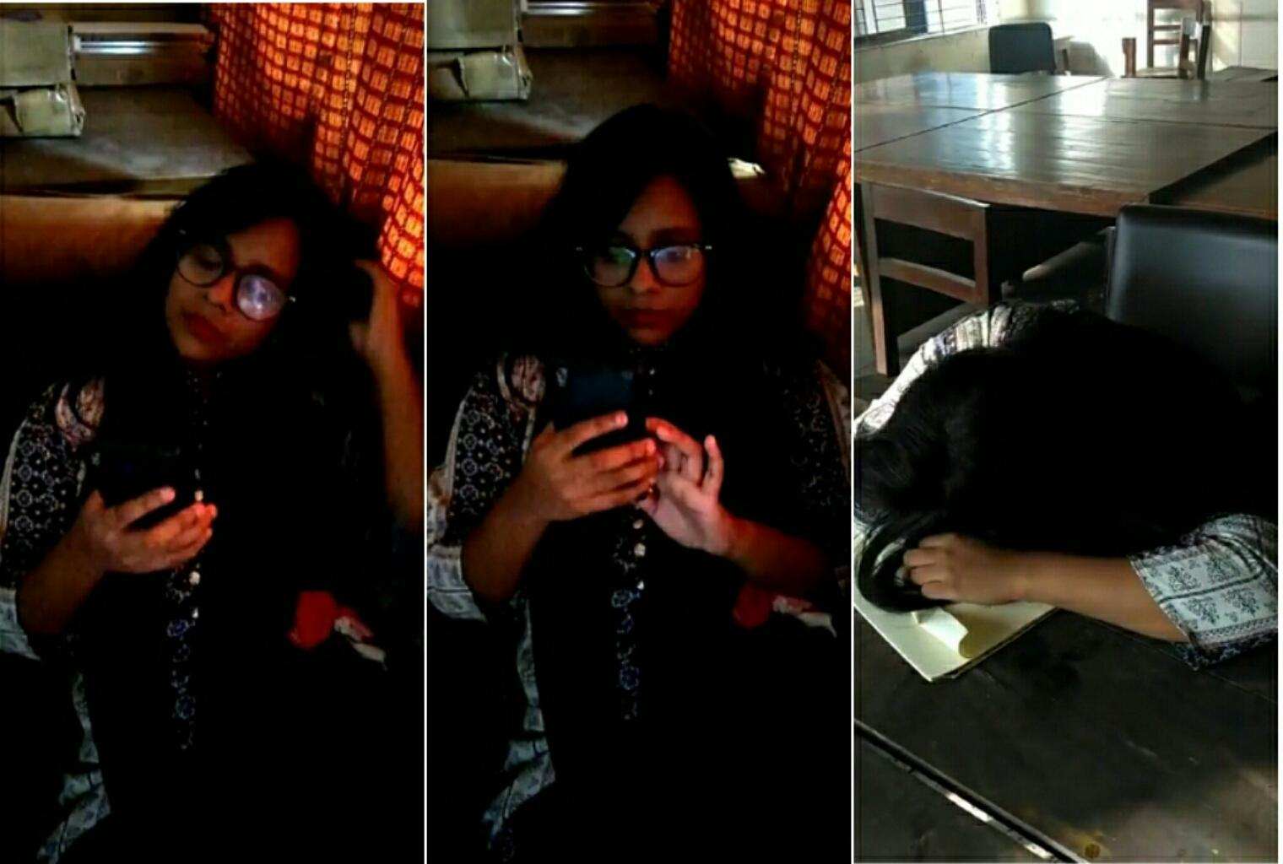
Scenario 3
Melody has a busy day tomorrow. But, she lost track of time and slept later than she intended to. She is exhausted all day.
track of time.

Slide 8
What we Need
We need something to utilize our time as we plan.
Reduce all these distractions and focus on the current activity
A healthy lifestyle
Nudge ourselves towards productivity

Slide 9
How we approached towards the solution

Slide 10
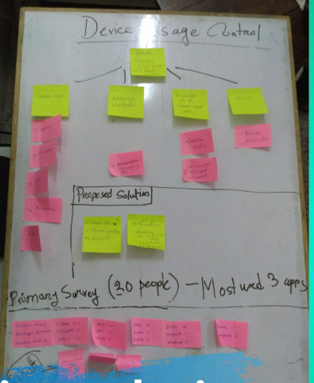
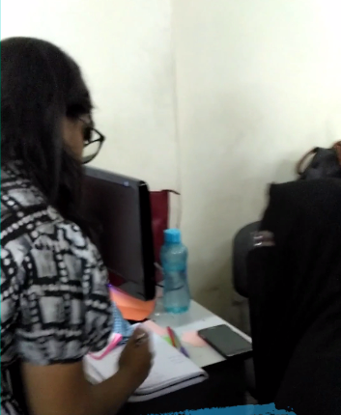
Brainstorming and Primary Survey

Slide 11
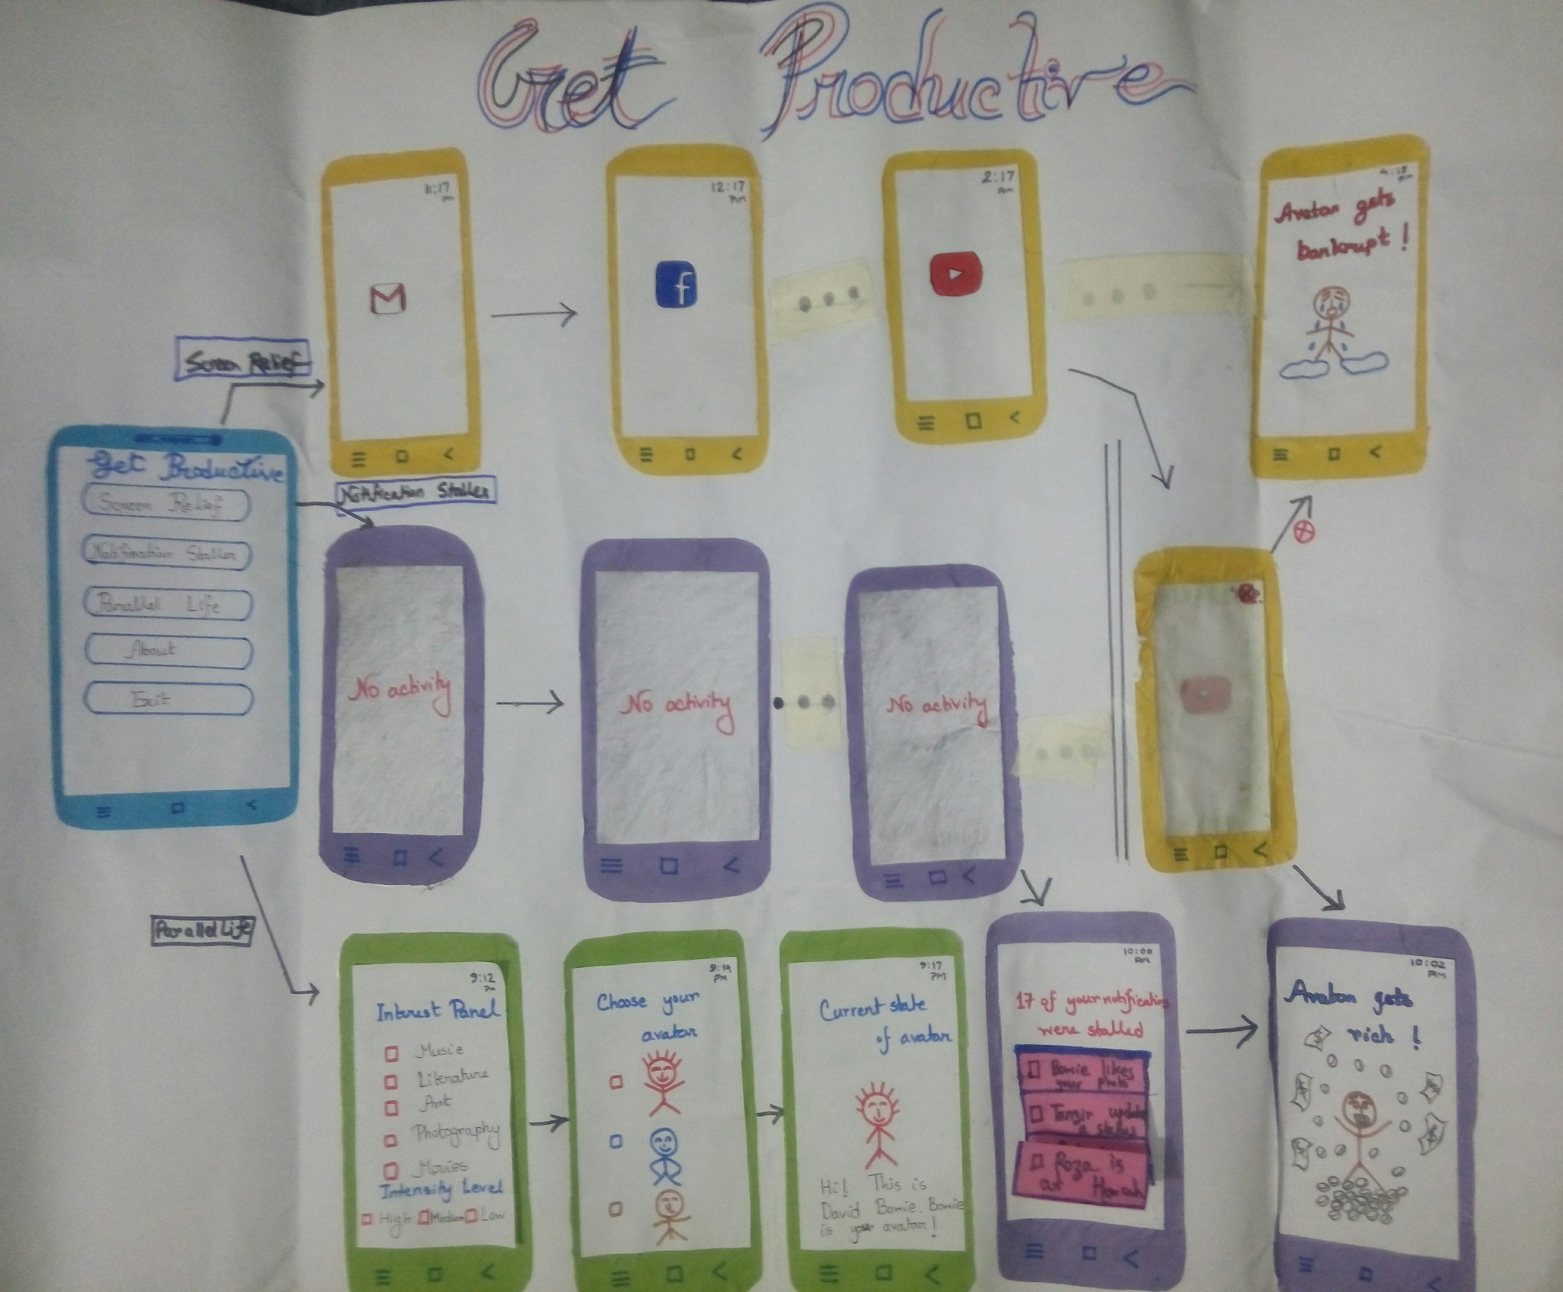
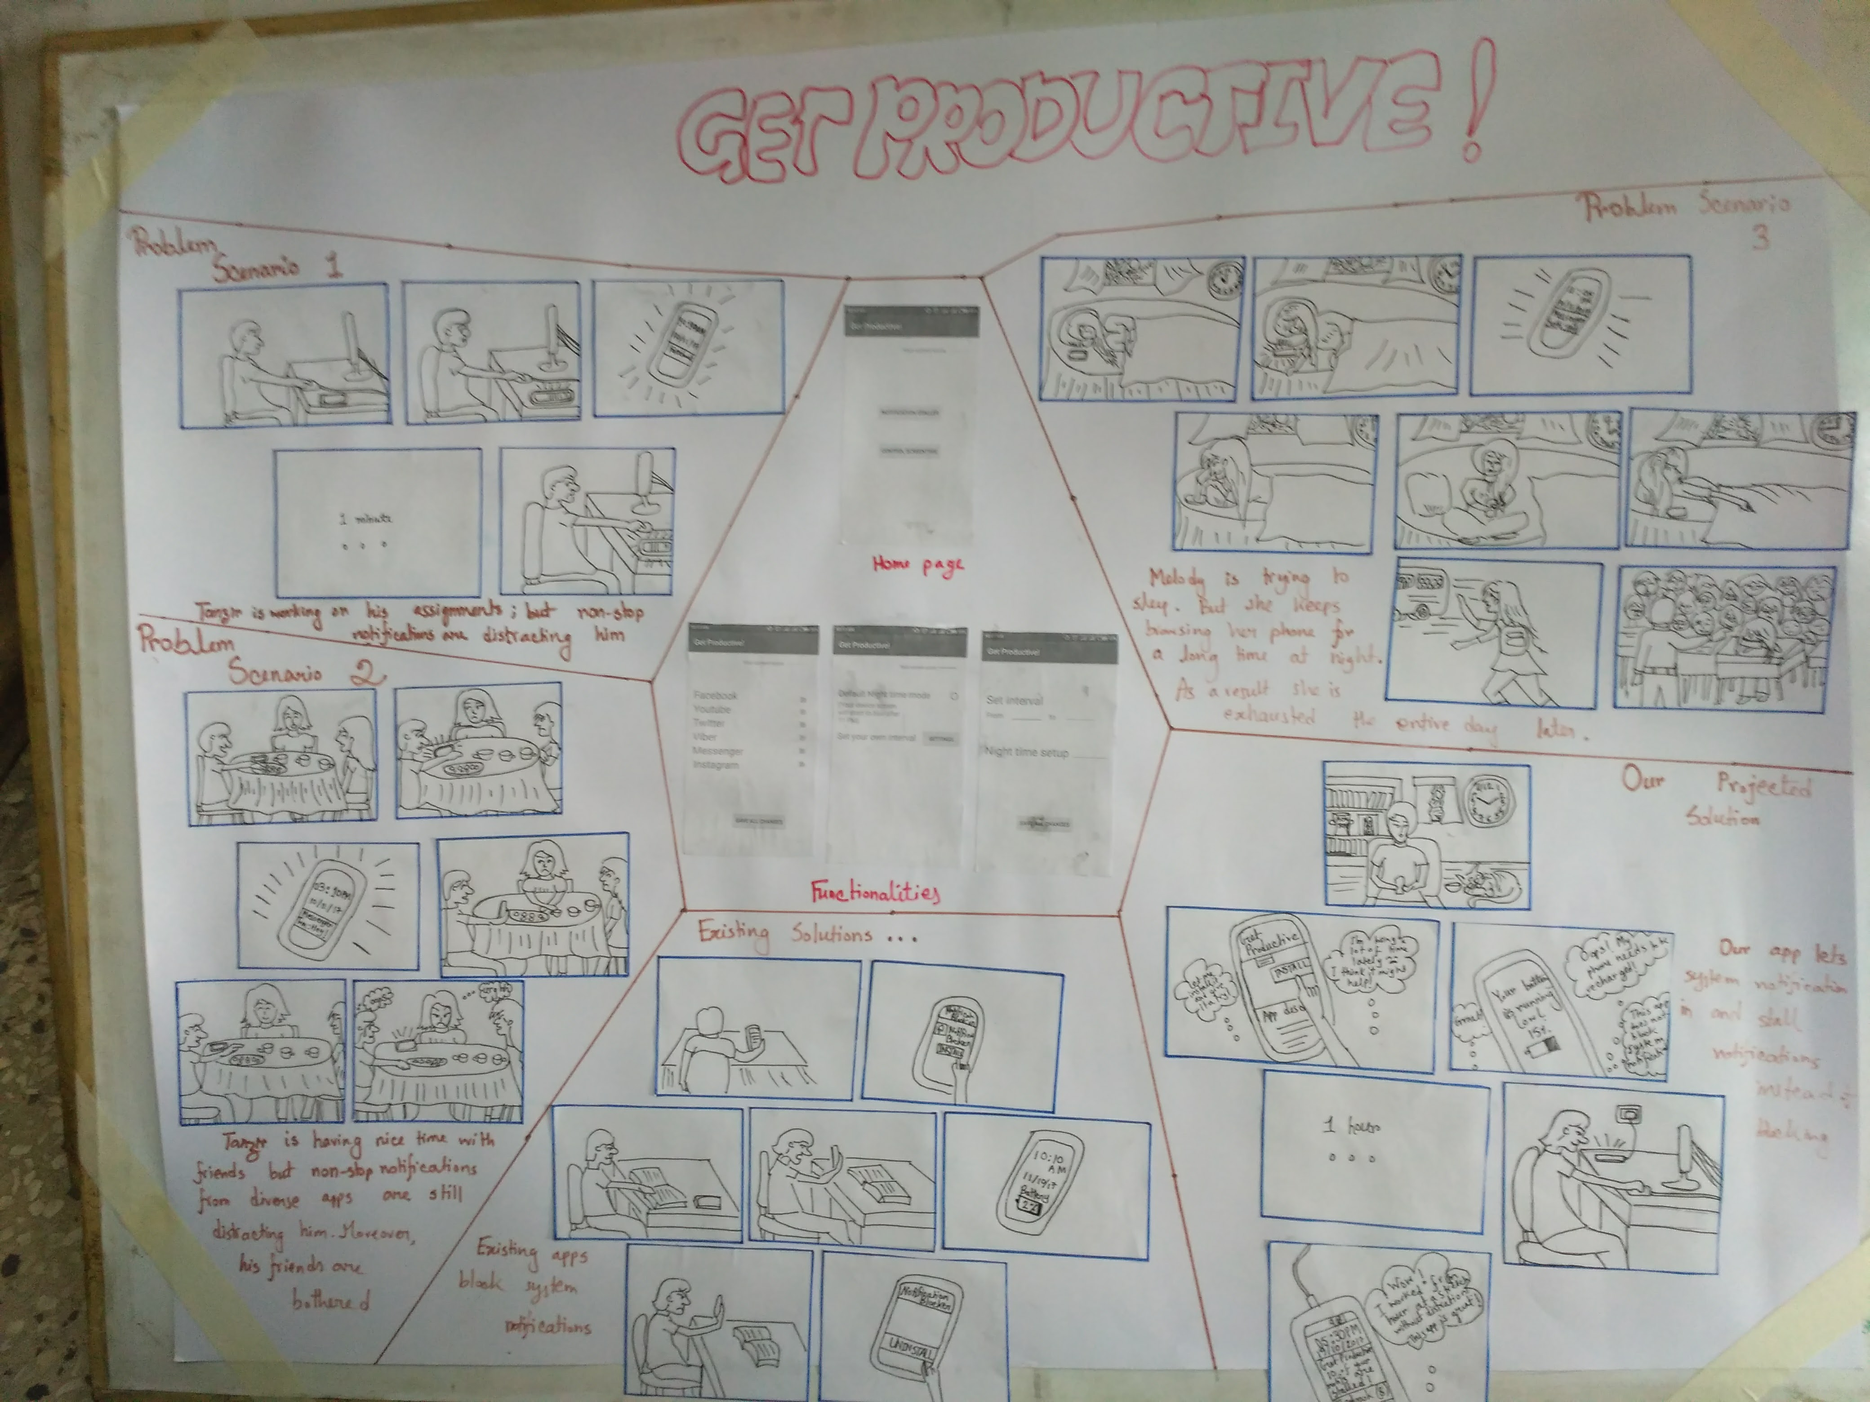
Paper Prototyping and StoryBoarding

Slide 12
Proposed solution
Keeping track of night time smartphone usage
A point based system to involve the user more
Alerting the user on preset time for sleep
Stalling notifications to facilitate productivity – instead of blocking them

Slide 13
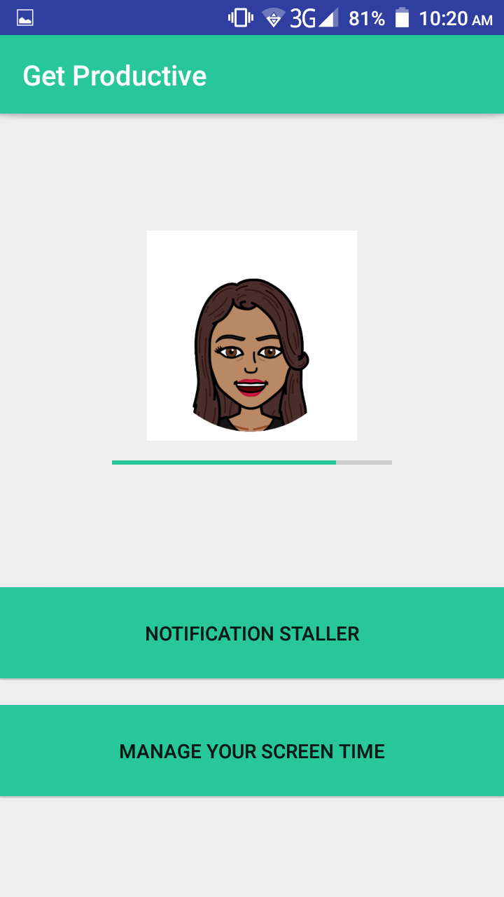
Looks like this

Slide 14
Basic activities...
Manages screen time usage
Motivates user to reduce screen-time in a non-controlling manner
Implements a nonconscious behavior change intervention
Uses Gamification as a catalyst via a relatable avatar

Slide 15
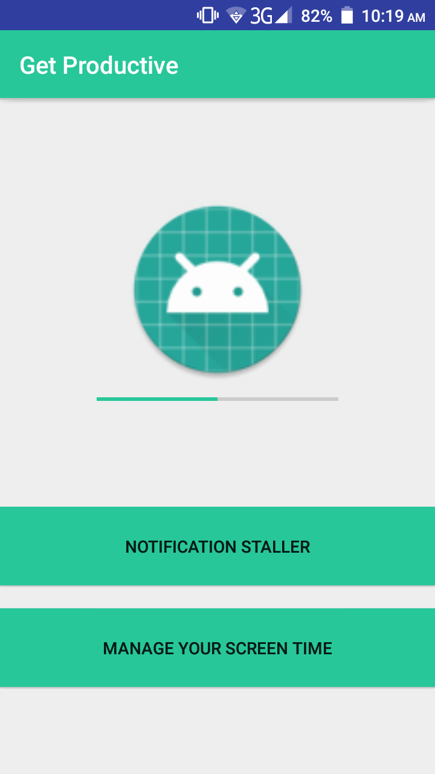
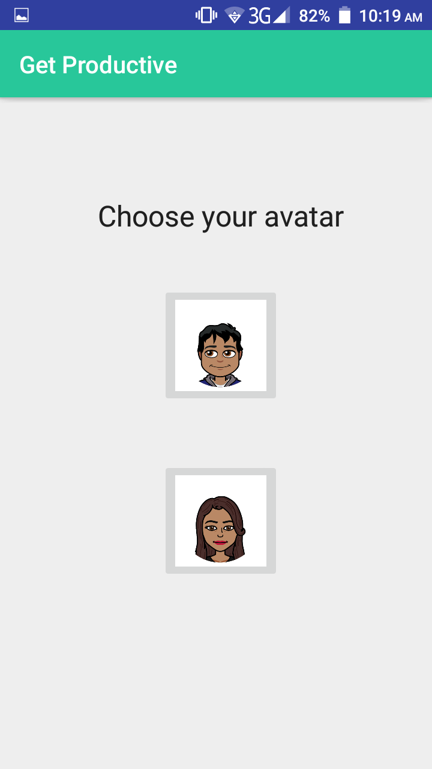
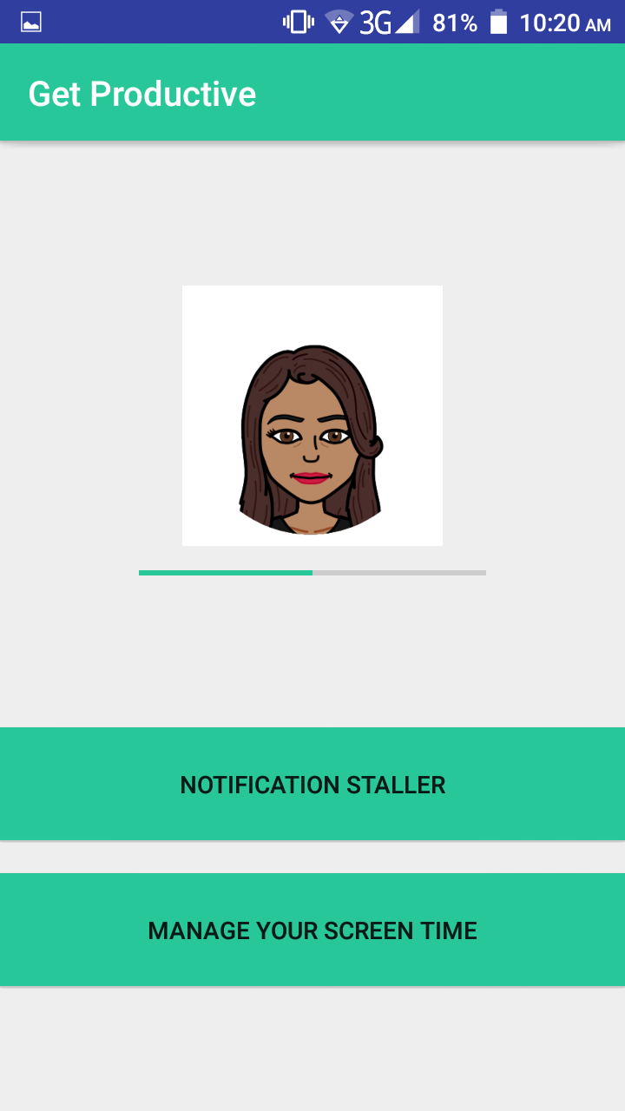
Work flow

Slide 16
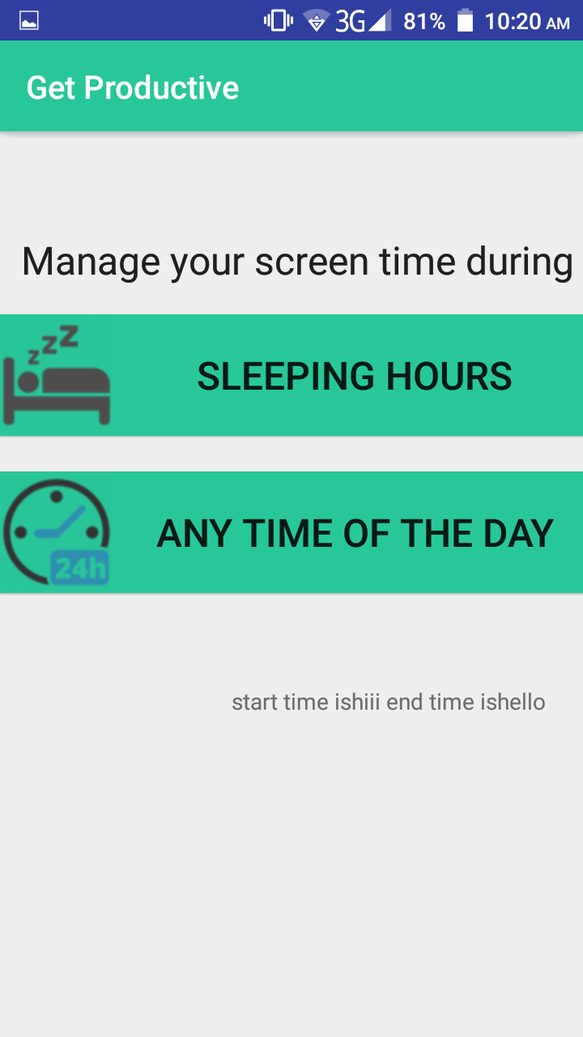
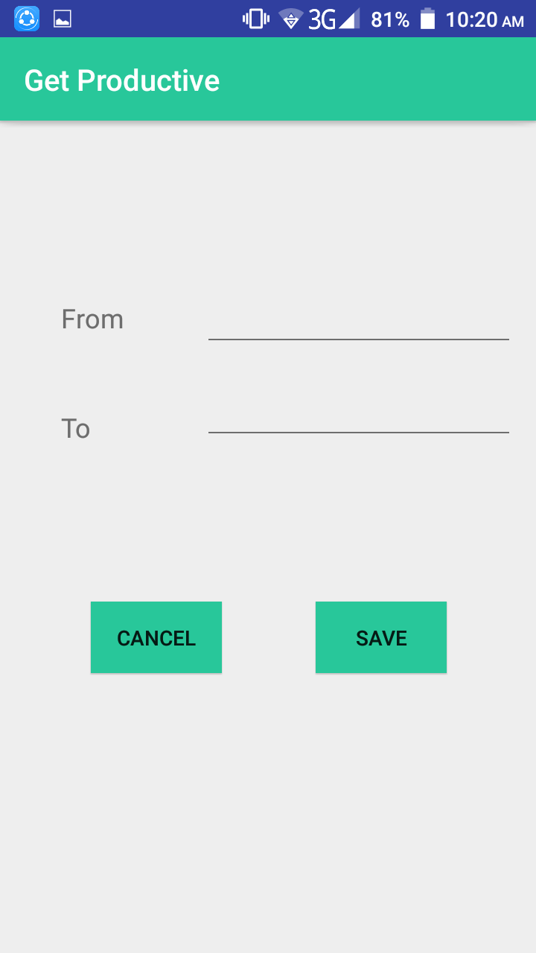
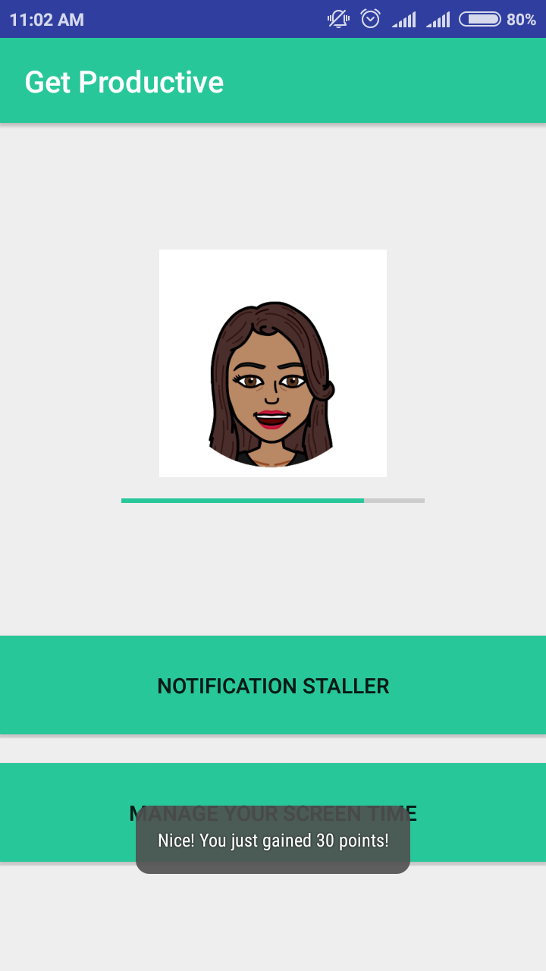
Work flow

Slide 17
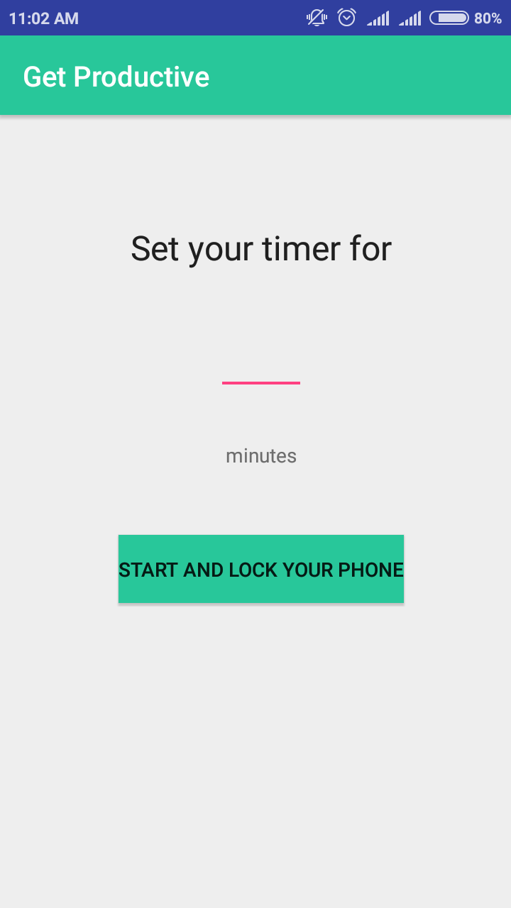
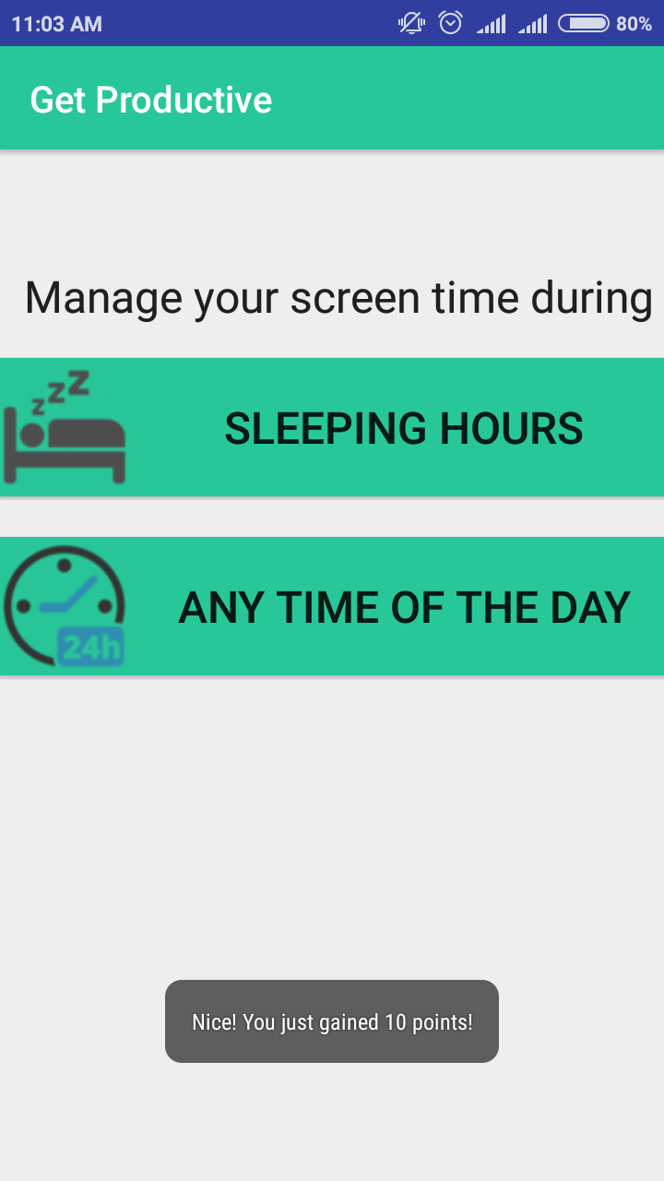
Work flow

Slide 18
User Response

Slide 19
User Response
The application was tested on 16 anonymous users. All of them had used such application before, and discarded them.
Twelve of the users have responded positively.
They have specifically attributed their response to the addition of avatars.

Slide 20
Future Directions

Slide 21
Future Directions...
Implementing full notification-stalling mechanism
In-built user behavior-pattern analysis for further evolution of the service
Social community based platform to engage mass users

